Slide 1

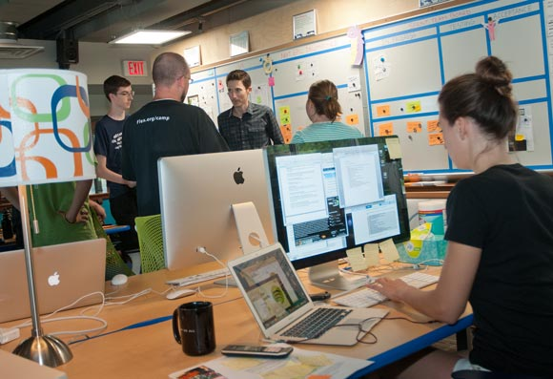
Entrepreneurship
Small Business
Scalable Startup

Slide 2
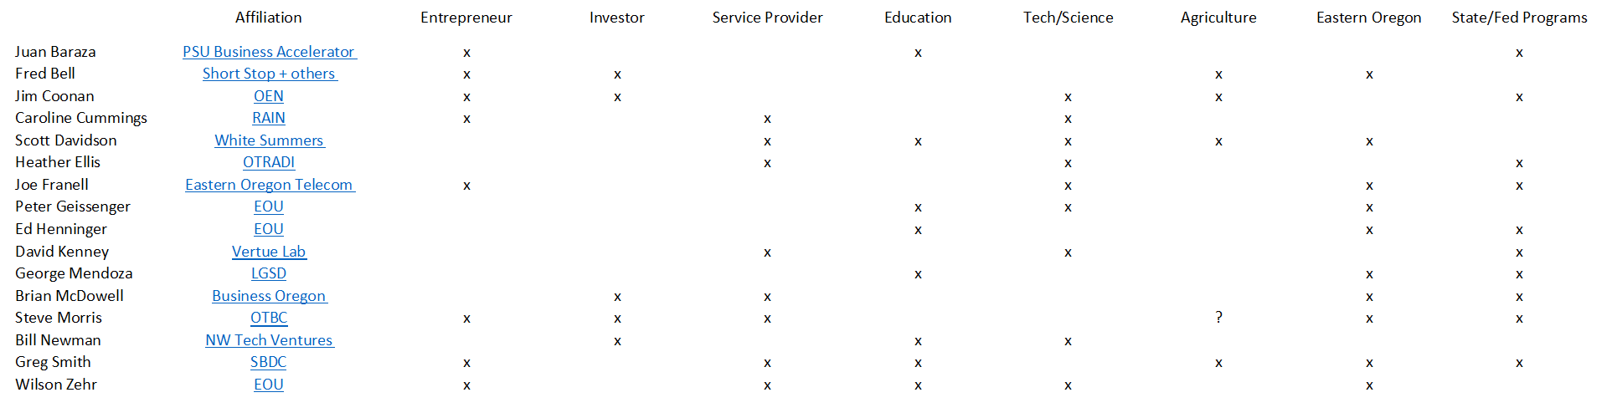
Entrepreneurship Advisory Board

Slide 3
Business Lifecycle
$$$
growth rate
returns
$$
BIG
idea
operational
complexity
$
0
time
n
investment
required

Slide 4
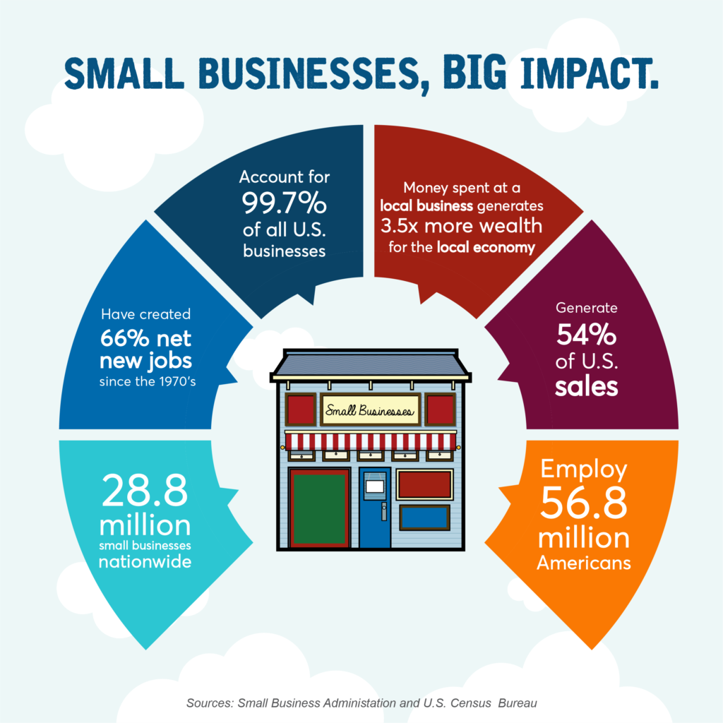
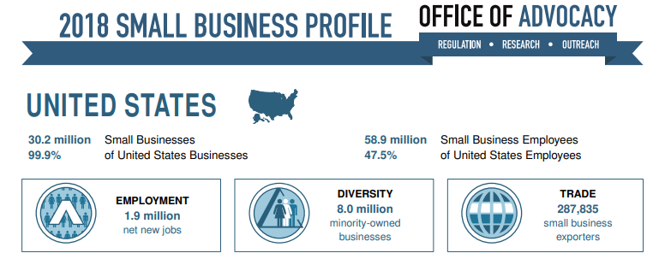
Small Business
wage rate benefits turn-over
. . . traded sector

Slide 5
Business Lifecycle
Small (Lifestyle) Business
sale or shut-down
10+ years
$$$
$$
growth rate
returns
BIG-ish
idea
operational
complexity
revenue
$
expenses
0
67%
50%
33%
time
2
5
10
investment
required
64% < $10,000

Slide 6





What Do These Firms Have in Common?
1976
2004
1994
Tech Big 5
1998
1975
Did NOT Exist Before 1975!

Slide 7
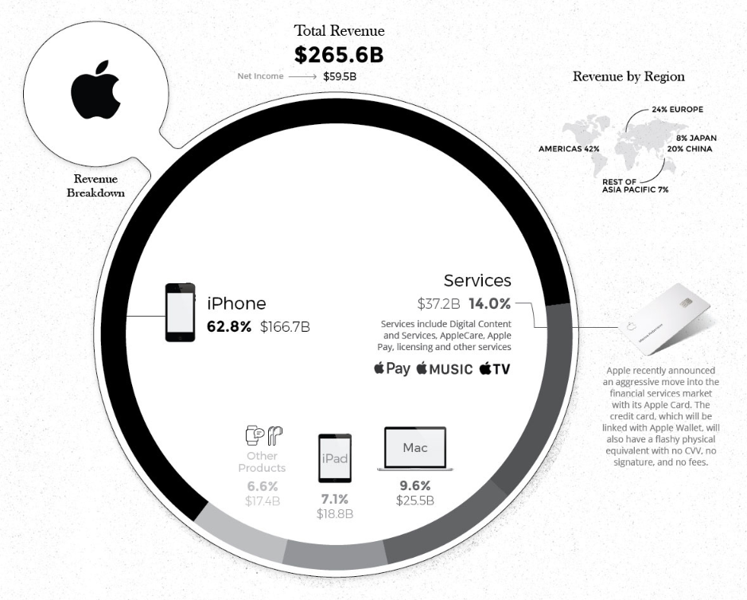
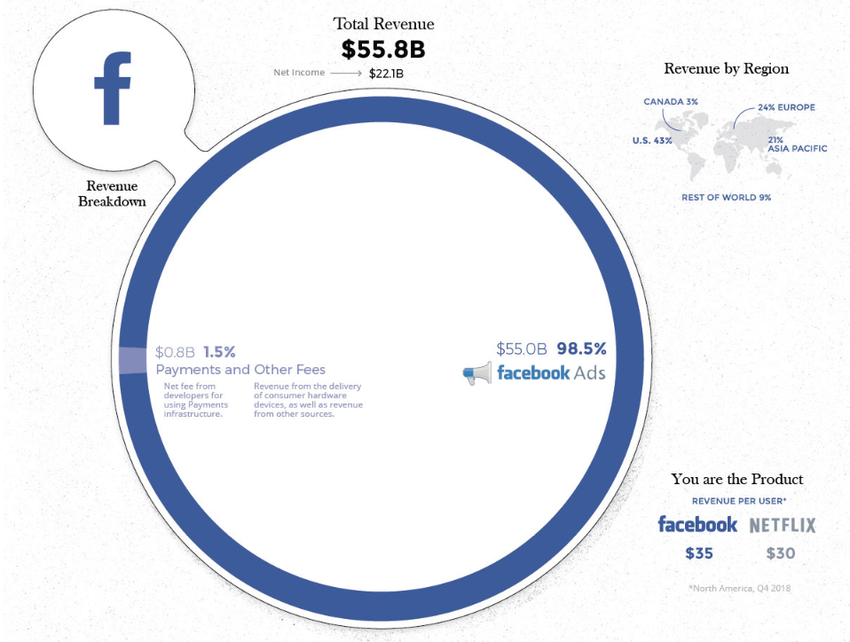
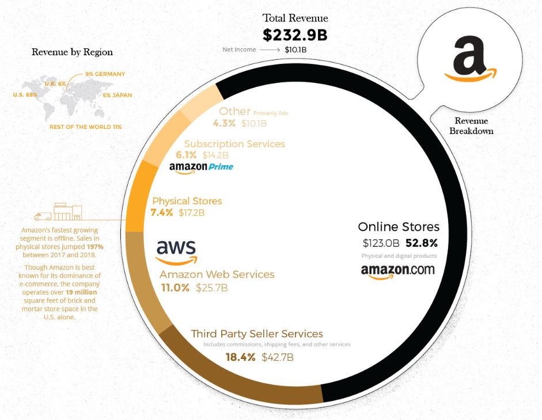
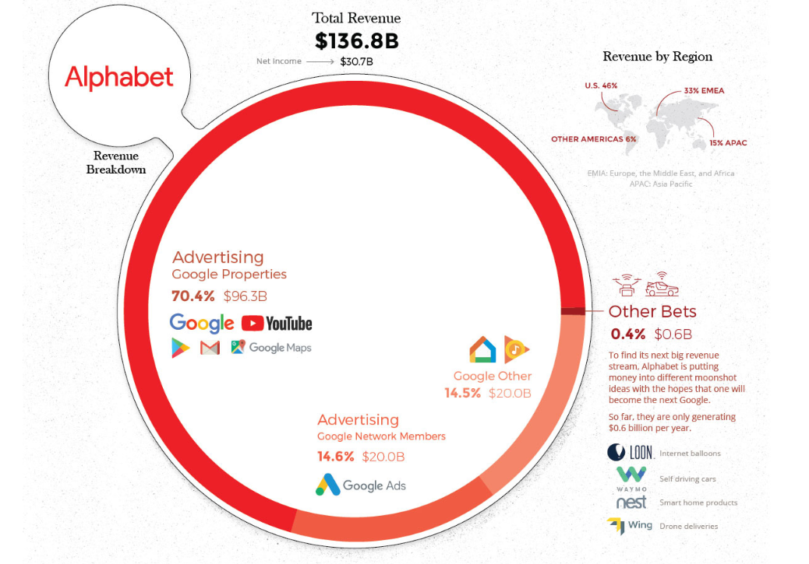
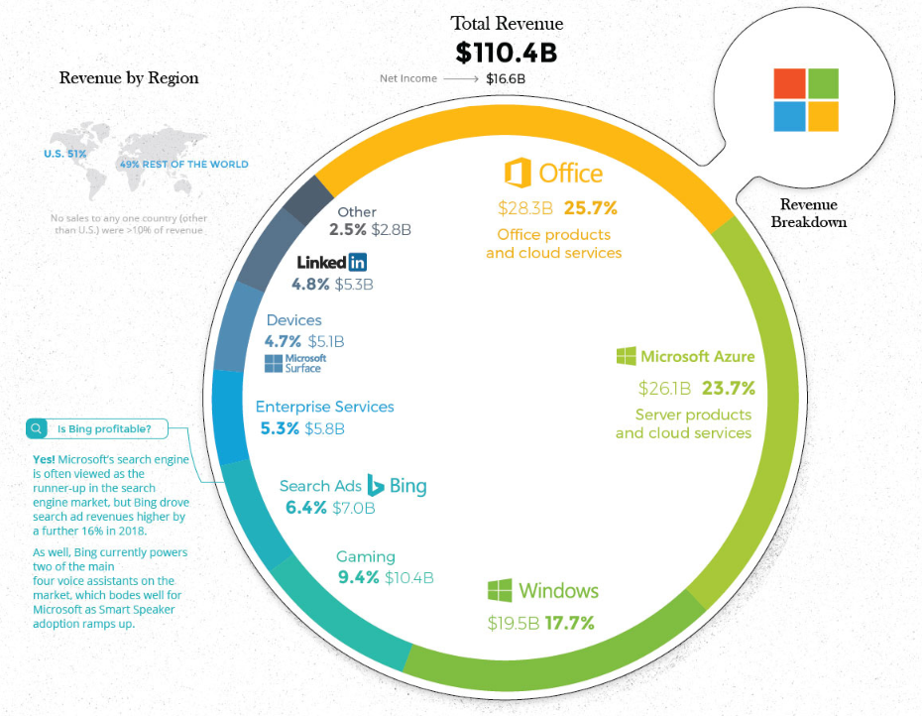
COMBINED
1 million+ employees
$802 billion revenue
$6.8 trillion market cap
Desjardins, J. (2019)
Innovation Responsible for 80% of U.S. Economic Growth Since World War II (Atkinson, 2011)
Creative Destruction (Schumpeter, 1934)

Slide 8
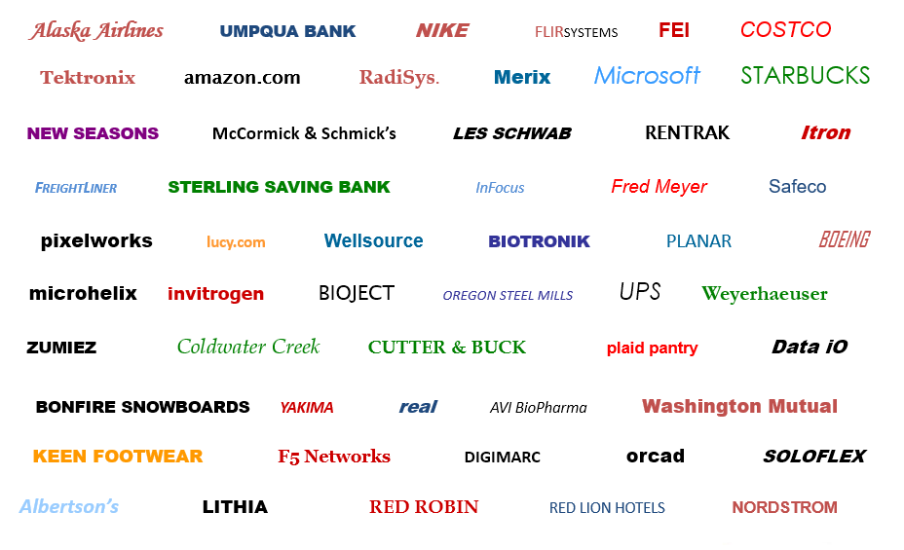
Northwest Success Stories…

Slide 9
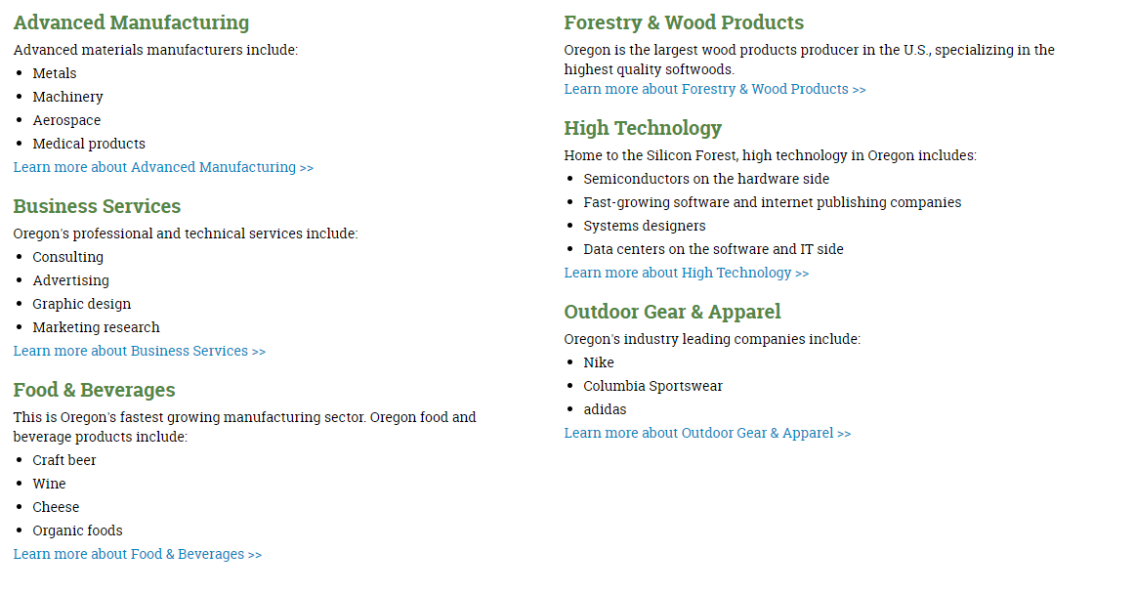
Oregon’s Target Traded Sector Industries
Learn more about Forestry & Wood Products >>
Learn more about Advanced Manufacturing >>
Learn more about High Technology >>
Learn more about Business Services >>
Learn more about Outdoor Gear & Apparel >>
Learn more about Food & Beverages >>

Slide 10
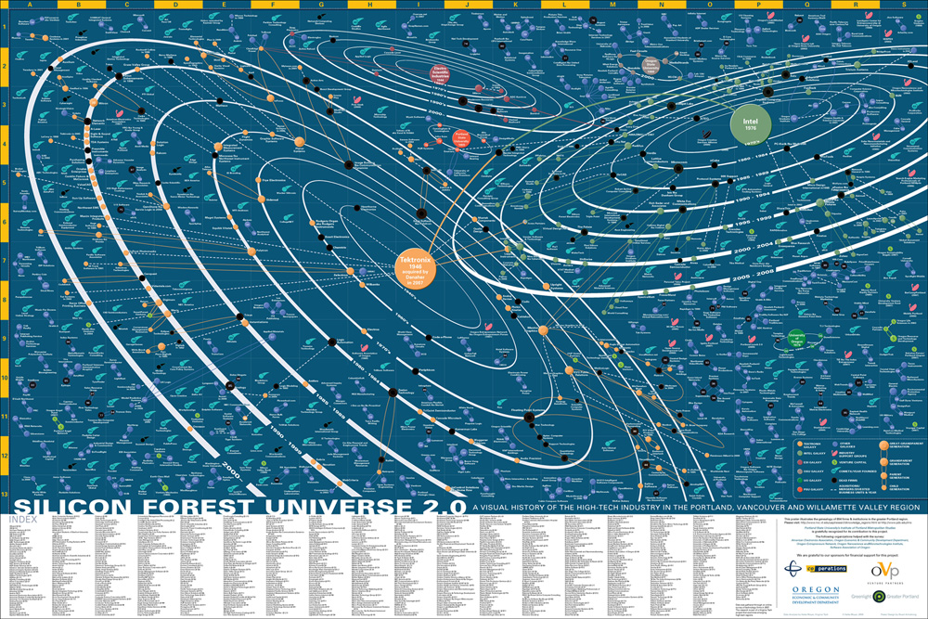
ESI
OSU
Intel
PSU
Tektronix
UO
Oregon Technology Universe (2007)

Slide 11
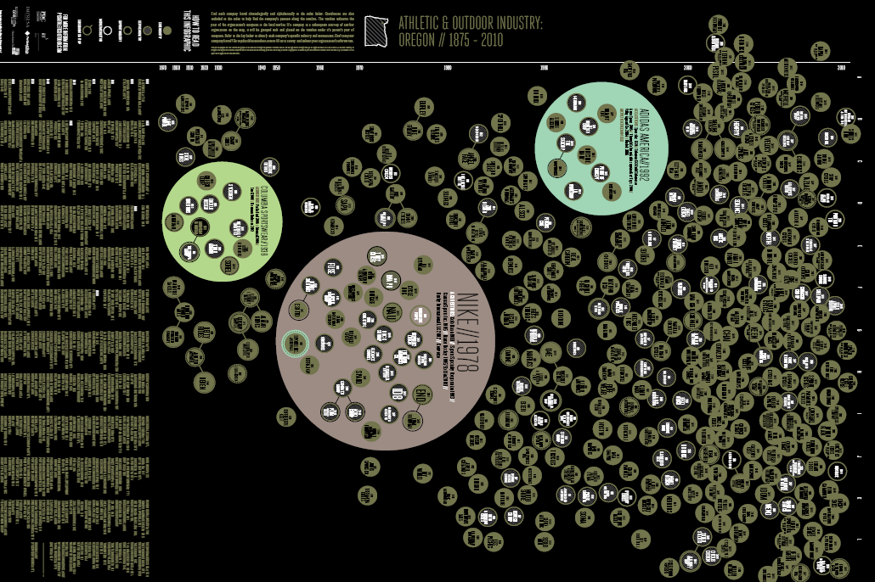
http://aoportland.com/wp-content/uploads/2012/12/Athletic-and-Outdoor-Industry-Poster.pdf
+Under Armour (2017)
Active Sports

Slide 12


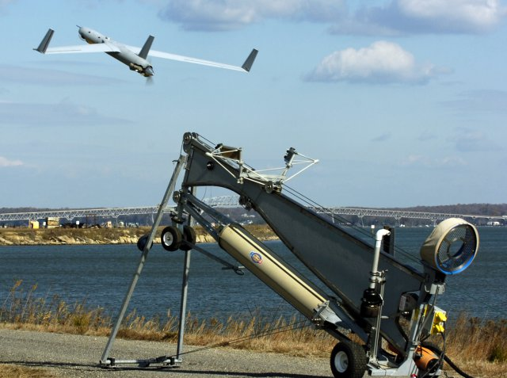


Insitu
Advanced Manufacturing

Slide 13
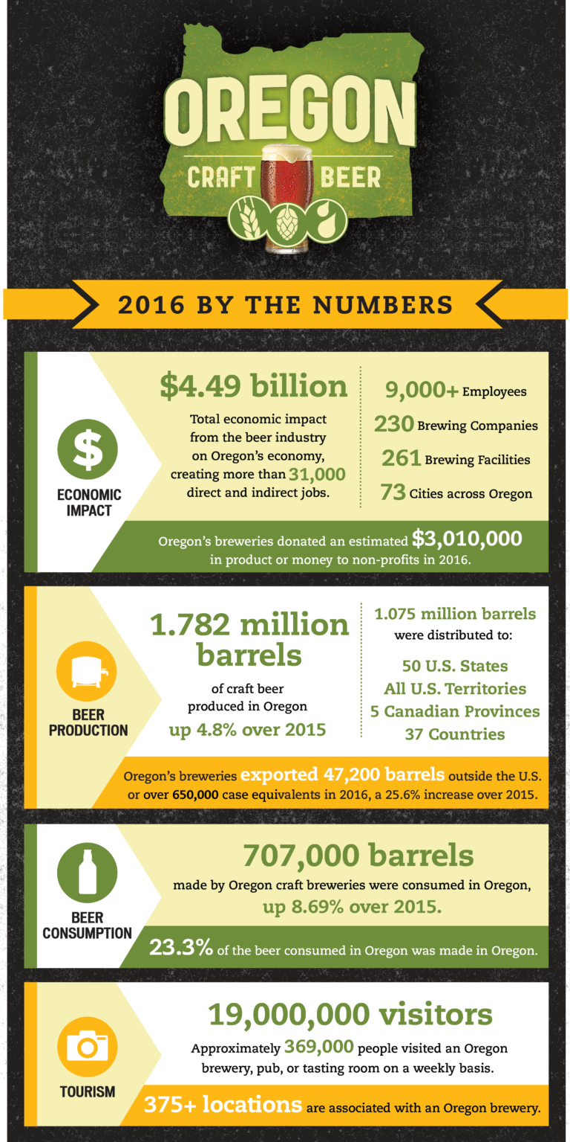
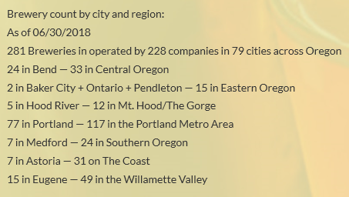

Entrepreneurship: Regional Industry

Slide 14
Business Lifecycle
Scalable Startup
acquisition or IPO
(5 – 7 years)
$$$
BIG
idea
growth rate
returns
revenue
operational
complexity
expenses
$$
$
30%
17%
1%
target VC investment
timeline 10 years
0
time
3
4.5
5
6.0
7
Investment required
series A avg $13M ($8M median)
series B avg $32 M
series C avg $55 M
…
seed
A
B
C
D
venture finance is not a requirement, but might be available to some …

Slide 15
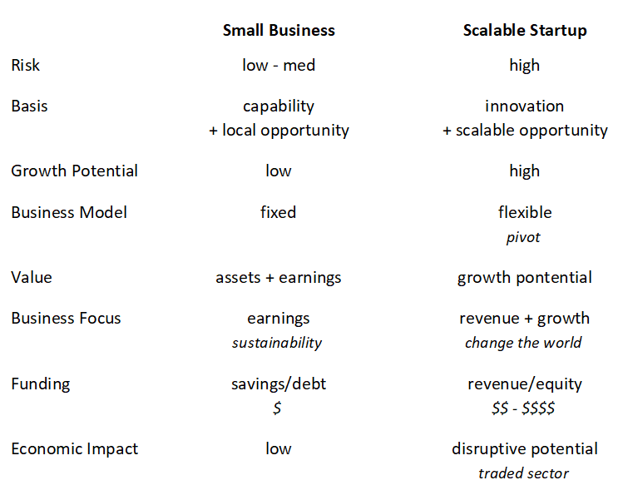

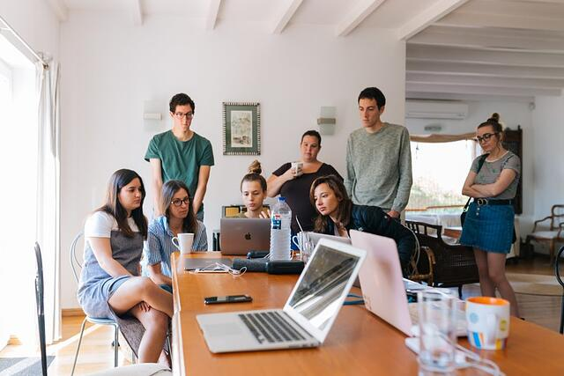
Small Business vs. Scalable Startup
https://www.universitylabpartners.org/blog/startup-vs-small-business

Slide 16

Where Should We Focus?

Slide 17

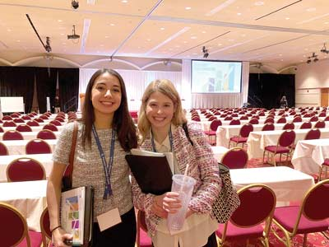

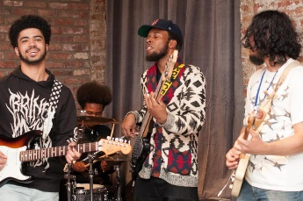

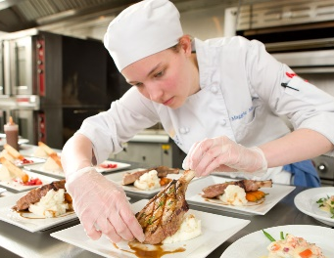
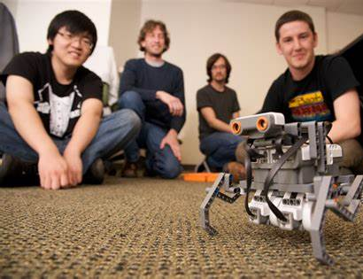
Segmentation
SBDC
Community Colleges
OEN, RAIN, EDCO…
4-year Universities

Slide 18




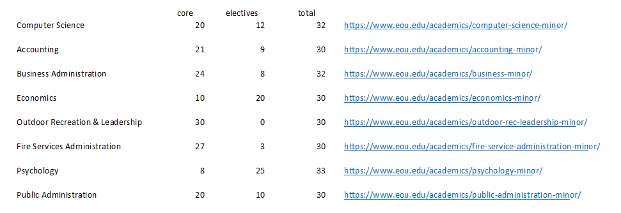
Entrepreneurship Minor
Design Requirements
Available to every university student (community member)
No prerequisites that add to core requirements
Use existing courses where possible
Launch Fall 2021
Practical skills required to launch/run a startup venture
small business already well-served…
Lean more towards startup than small business (university)
Provide a pathway to business creation and ownership
…
EOU examples
existing minors
30 – 32 credits

Slide 19

Entrepreneurship Minor
credits course title
4 BA 2xx^{e} By the Numbers
4 BA 312 Principles of Marketing
4 BA 321 Principles of Management
4 BA 460 Entrepreneurship
4 BA xxx^{m} Creativity & Innovation
4 BA xxx^{m} Sales Process & Technique
4 BA 346 Digital Marketing Fundamentals
pick one (or more)
4 BA xxx^{e} Social Entrepreneurship
4 BA xxx^{e} Virtual Enterprise
4 BA 450 Retailing & Customer Connections
32 total
xx^{e} – specific to Entrepreneurship Minor
xx^{m} – new course used in Marketing Degree

Slide 20
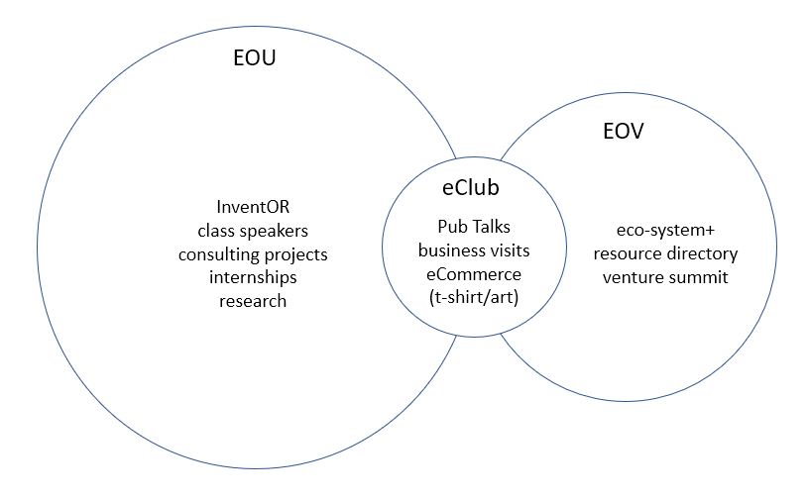
Entrepreneurship Minor
credits course title
4 BA 2xx^{e} By the Numbers
4 BA 312 Principles of Marketing
4 BA 321 Principles of Management
4 BA 460 Entrepreneurship
4 BA xxx^{m} Creativity & Innovation
4 BA xxx^{m} Sales Process & Technique
4 BA 346 Digital Marketing Fundamentals
pick one (or more)
4 BA xxx^{e} Social Entrepreneurship
4 BA xxx^{e} Virtual Enterprise
4 BA 450 Retailing & Customer Connections
32 total
xx^{e} – specific to Entrepreneurship Minor
xx^{m} – new course used in Marketing Degree
supporting activities

Slide 21
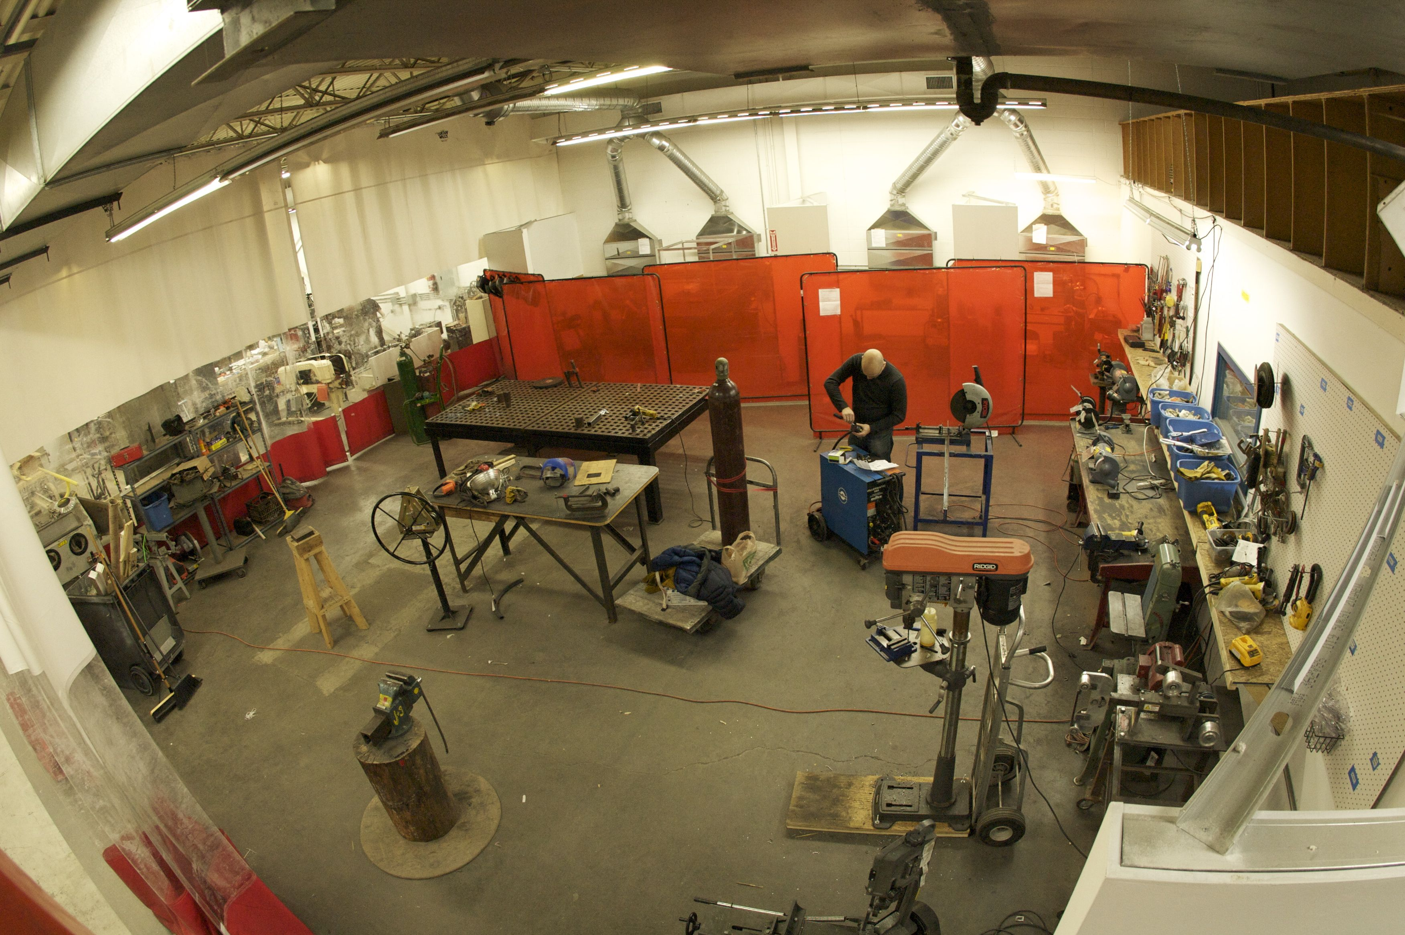


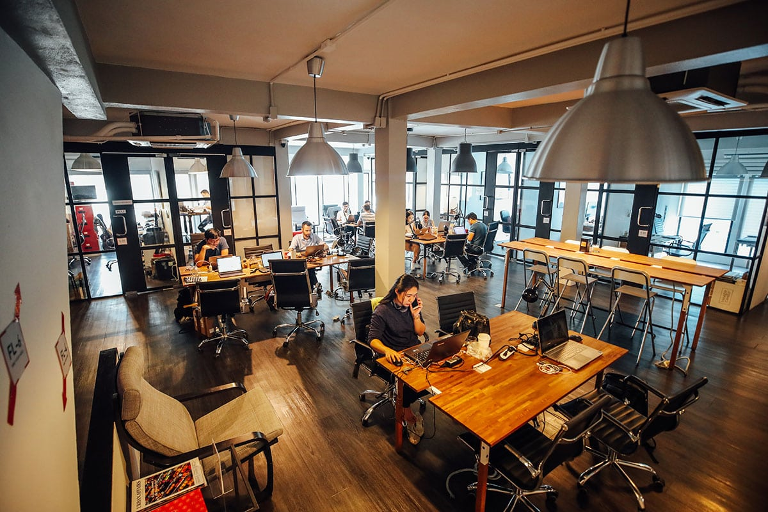
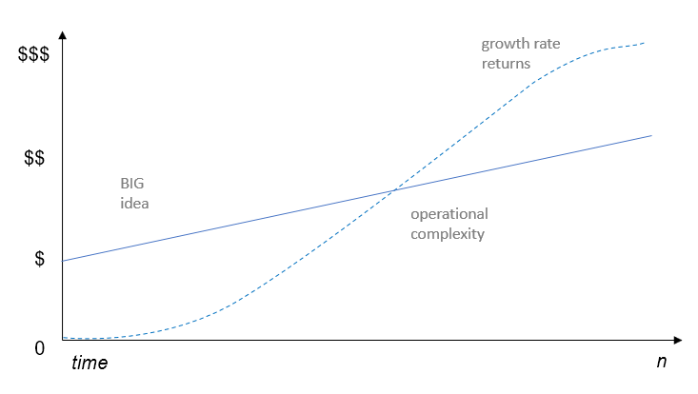
Startup Spaces
Makerspace
equipment + guidance
Concept stage
Proto-typing
Focus varies
  art
  technology
  Industrial
  food
Community connect
Incubator
space + guidance
Seed stage
Planning
Formation
Product launch
Seed funding
Accelerator
guidance +/- space
Seed+ stage
Validation
Potential Pivot
Sales Expansion
Institutional Funding
Co-Working Space
office space
Full lifecycle
  size vs. stage
Office space
Shared resources
Community (relationships)

Slide 22






Maker/Accelerator Options
+ community
partners
Regional Accelerator & Innovation Network
Beaverton Startup Challenge
& Incubator
virtual rural version
Eastern Oregon Ventures

Slide 23
Entrepreneurship Minor
credits course title
4 BA 2xx^{e} By the Numbers
4 BA 312 Principles of Marketing
4 BA 321 Principles of Management
4 BA 460 Entrepreneurship
4 BA xxx^{m} Creativity & Innovation
4 BA xxx^{m} Sales Process & Technique
4 BA 346 Digital Marketing Fundamentals
pick one (or more)
4 BA xxx^{e} Social Entrepreneurship
4 BA xxx^{e} Virtual Enterprise
4 BA 450 Retailing & Customer Connections
32 total
xx^{e} – specific to Entrepreneurship Minor
xx^{m} – new course used in Marketing Degree
make it real
idea lab (PSU)
maker space (virtual)
Incubator (OTBC)
accelerator (RAIN)
sequential or parallel?

Slide 24
BACKUP

Slide 25
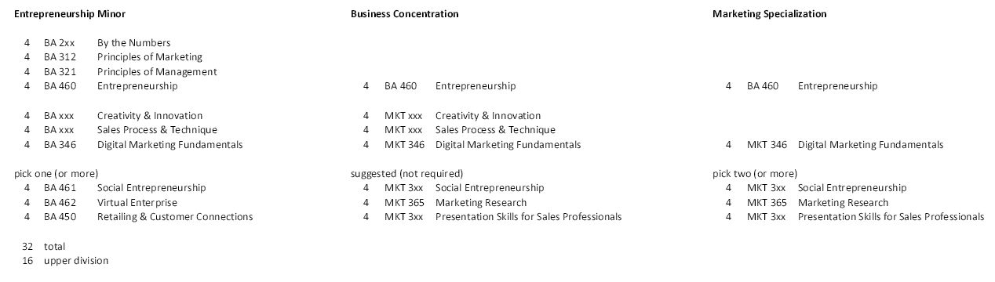
Entrepreneurship - CoB Options

Slide 26
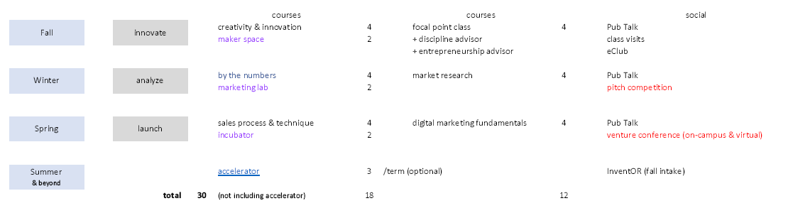
Entrepreneurship – Experiential Option
Collaborative Model

Slide 27
Entrepreneurial Eco-System
infrastructure
resources
high growth enterprise
role of big business
virtual enterprise
traded sector
knowledge
discovery
application
talent
entrepreneurs
employees
hero’s
mentors
capital
early stage
expansion stage
networks
service providers
culture
https://hbr.org/2014/05/what-an-entrepreneurial-ecosystem-actually-is
http://www.oecd.org/cfe/leed/Entrepreneurial-ecosystems.pdf

Slide 28
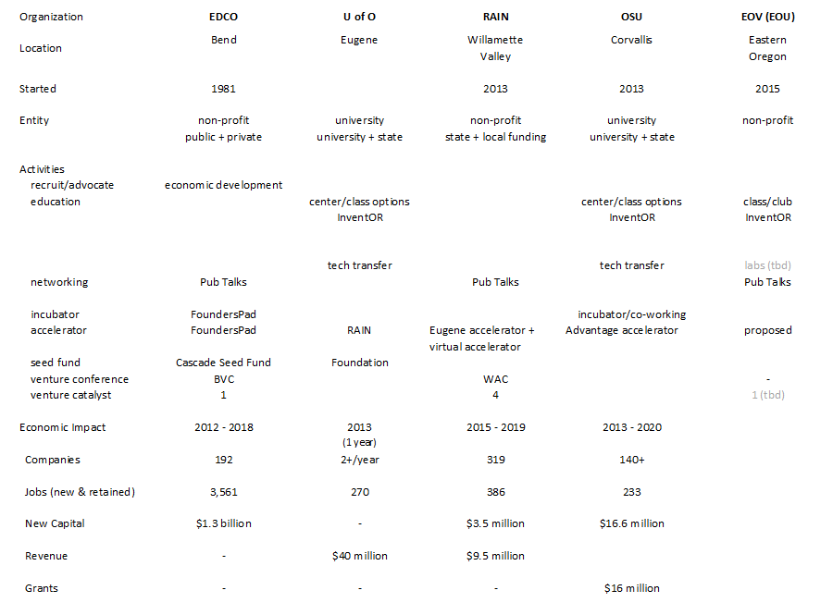
Activities
& Impact

Slide 29
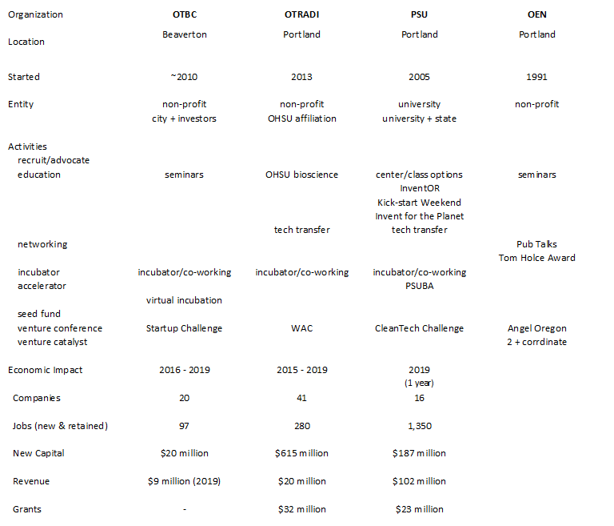
Activities
& Impact

Slide 30



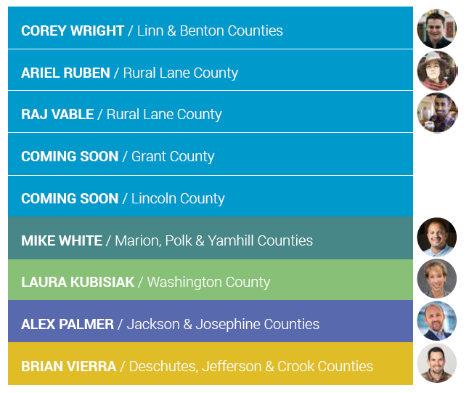



Venture Catalyst
https://www.oen.org/programs-services/oen-angel-oregon/

Slide 31
Center for Entrepreneurship
agricultural
ventures
manufacturing
ventures
outdoor recreation
ventures
e-business
ventures
grow
make
guide
surf
educating
coaching
funding
planning
connecting
operating
scaling
university
entrepreneur
community

Slide 32
Symbiotic Relationship
EOU
EOV
eClub
InventOR
class speakers
consulting projects
internships
research
Pub Talks
business visits
eCommerce
(t-shirt/art)
eco-system+
resource directory
venture summit
Potential Programs:
Maker Space
Incubator/Accelerator
Food Tech Center
National Labs
University Activities
NOT an official EOU program

Slide 33

Stage vs. Scale
scale
ACG
Industry Associations
EDCO/OEN/RAIN/OTBC
Accelerator
Incubator
Maker
startup
InventOR
ideation
liquidity
Ignite/Hatch
small business
SBDC/NEOEDD
Chamber
EO
90% less than 20
100% less than 100

Slide 34

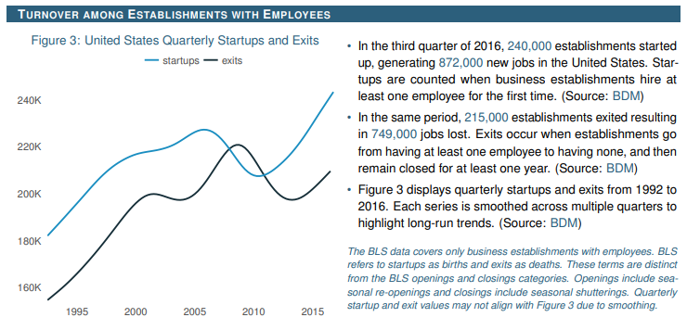
churn
U.S. Department of Labor

